Slide 1
Panda Climb
##Project##
Course : Advanced Programming Laboratory
Submitted to : Mahbuba Afrin
Student : Sharfaraz Mahmood Jamee
Id : 011161183
Section : NC

Slide 2
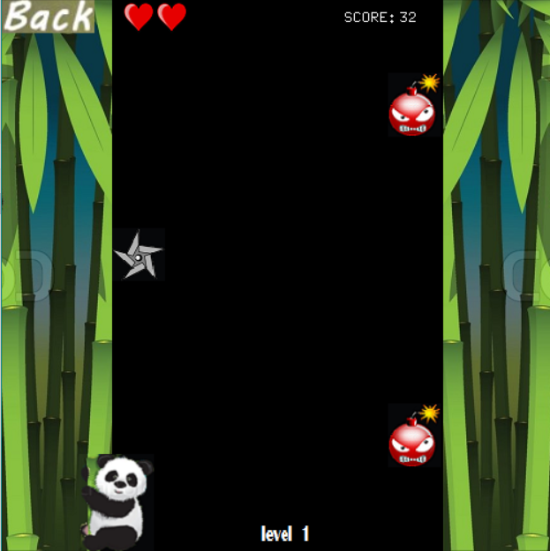
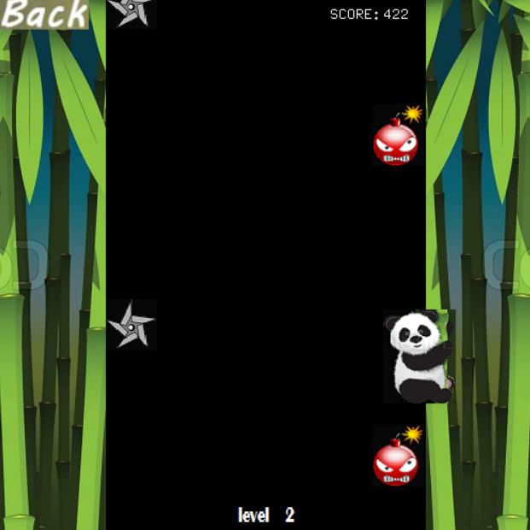
ABOUT THE GAME
A simple dodging game
Small in size
Takes small amount of memory
You have to be patient
And quick to response
Fun and a bit challenging to play
A game for everyone

Slide 3


How to play
Start the game and In the menu click on START and play the game
Use the ARROW KEYs of the keyboard to move the panda up ,down or left, right
By moving avoid the BOMBS & SHURIKENS
Keep an eye on the HEARTs and the LEVEL no
Your HIGHEST SCORE will be saved ,so you can challenge yourself
Use the QUIT in the menu or the END button to exit the game
Watch out for this two

Slide 4

LET’S GO PLAY THE GAME

